Slide 1

Google Guava
2014.10.24 CMS 유닛 경승호

Slide 2
Google Guava?

Slide 3

Google Guava?

Slide 4
Google Guava?
Google Core Library (JavaSE 5.0 +)
􏰀구글 자바 프로젝트에서 기본적으로 사용 􏰀
Google Guava로 명칭을 통일
􏰀Andorid 개발 지원
􏰀GWT 개발 지원
􏰀Apache license 2.0

Slide 5
Google Guava?
Apache Commons Lang
컴포넌트
Google
Guava
=
Apache Commons Collections
컴포넌트
유용한 유틸리티

Slide 6
Google Guava?
Apache Commons Library
프로그램의 공통적인 기능을 재사용하기 위한 목적으로 시작
􏰀Google Library와 더불어 전􏰁계적으로 가 장 많이 사용되고 있는 Library
􏰀현재 Commons Library는 40여개의 컴포 넌트들로 구성
􏰀각각의 컴포넌트를 필요에 따라서 선택적 으로 사용하는 것이 가능

Slide 7
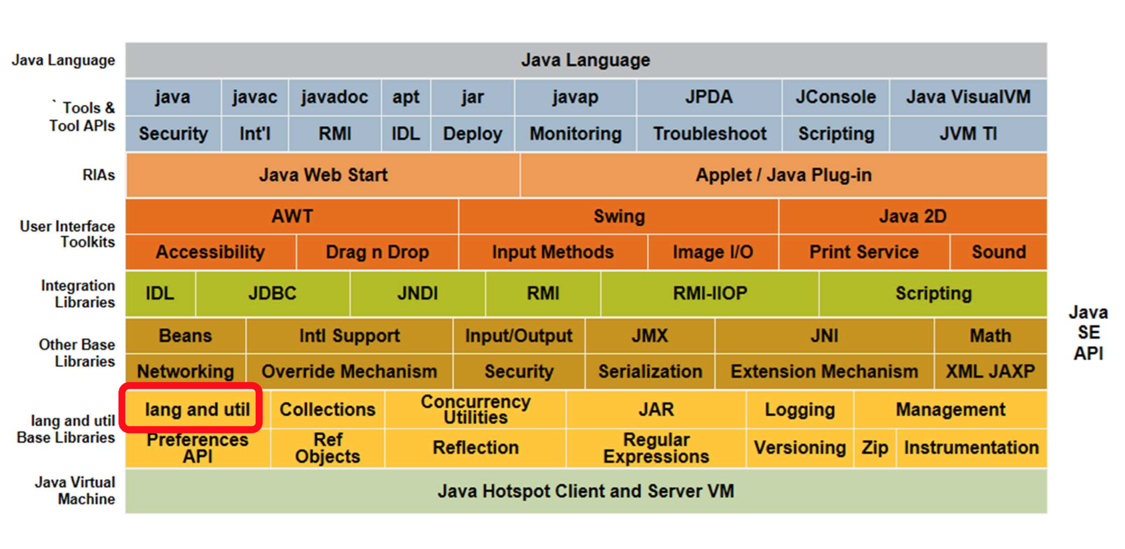
Google Guava?
java.lang.*

Slide 8
Google Guava?
java.lang.* Packages
Basic Class
Object, Process, Runtime, System, Thread, Class, ClassLoader
􏰀Wrapping Class
Boolean, Byte, Character, Double, Float, Integer, Long 􏰀
String Class
String, StringBuffer, StringBuilder

Slide 9
Google Guava?
java.lang.* Packages Features
Base Function
ObjectUtils, ClassUtils, ArrayUtils, BooleanUtils
􏰀문자열 조작
StringUtils, StringEscapeUtils, RandomStringUtils, Tokenizer, WordUtils 􏰀
Character 핸들링
CharSetUtils, CharSet, CharRange, CharUtils
JVM Interaction
SystemUtils, CharEncoding􏰀
Serialization
SerializationUtils, SerializationException􏰀

Slide 10
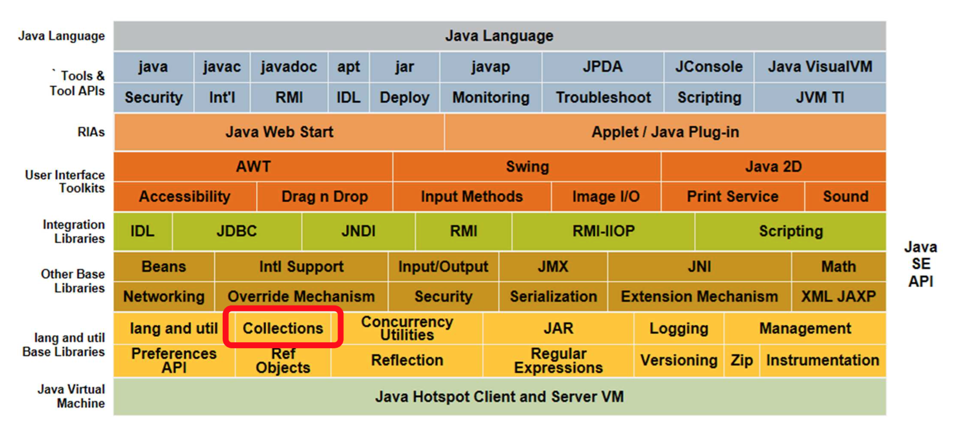
Google Guava?
java.util.*
10

Slide 11
Google Guava?
java.util.* Packages
Collections Class
ArrayList, Array, HashMap, HashSet, LinkedList, Vector, Stack􏰀
Utility Class
Timer, Random, Properties, Locale, Date, Calendar 􏰀

Slide 12
Google Guava?
java.util.* Packages Features
Collection 유틸리티
Ordered Maps
Bidirectional Maps
Queues
Buffers
Bags

Slide 13
Google Guava?
What is the problem?

Slide 14
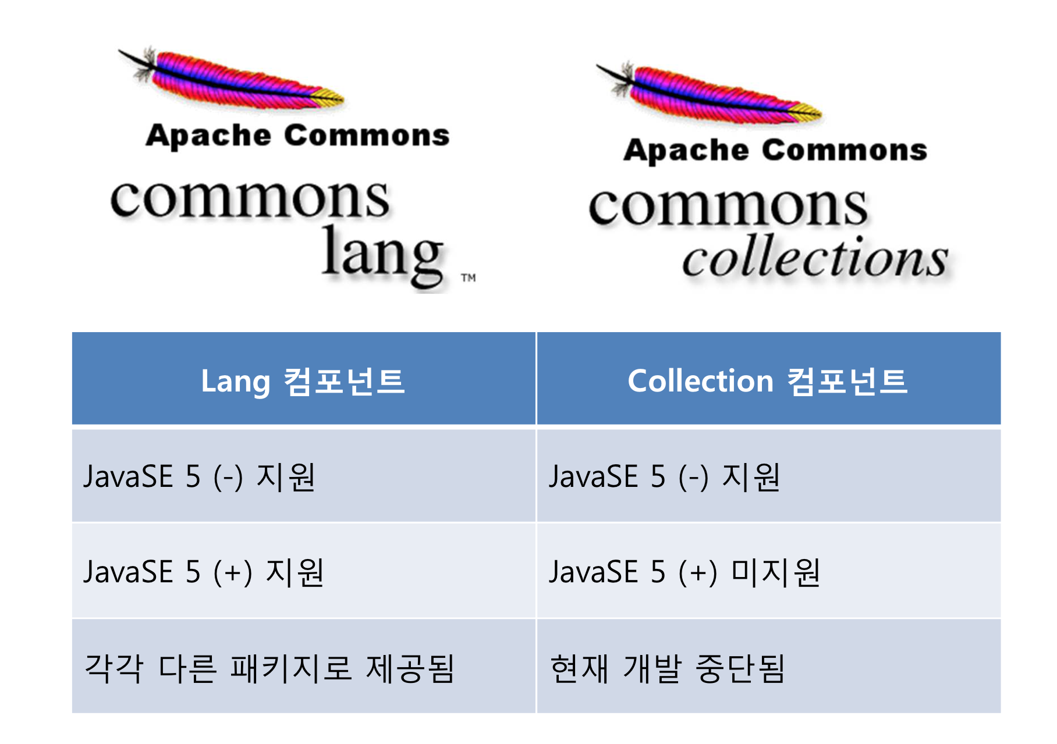
Google Guava?

Slide 15

Google Guava?
Release Note
Last Published
2014년 04월 09일 (Version:3.3.2)
Using CMS Version
Version:2.5
Commons Lang 2.x
JDK 1.2 ~ JDK 1.4 까지 지원 􏰀(org.apache.commons.lang.*)
Commons Lang 3.x
􏰀JDK 1.5 이상 지원 (org.apache.commons.lang3.*)
􏰀개발시 사용하는 JDK 기준으로 선택적으로 사용
􏰀필요에 의하여 혼용하여 사용 가능 (권장하지 않음)

Slide 16

Google Guava?
Release Note
Last Published
2013년 11월 27일 (Version 4.0)
Development stopped (2008년 4월 15일)
3.2.1 버전 기점으로 Commons Collections 개발중단 (Version 4 새로시작)
Using CMS version
Version:3.2
Commons Collections 라이브러리
JDK 1.2 ~ JDK 1.4 까지 지원 (org.apache.commons.collection.*)
개발시 사용하는 JDK 버전이 1.5 이상일 경우 사용을 권장하지 않음 (Version 4.0 권장)

Slide 17
Google Guava?

Slide 18
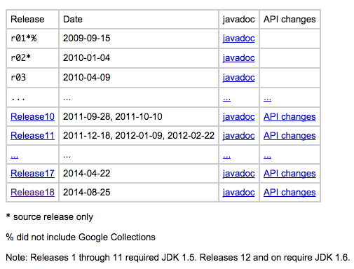
Google Guava?
https://code.google.com/p/guava-libraries/wiki/ReleaseHistory

Slide 19
Google Guava?
Release Note
Last Published
2014년 8월 25일(Version:Release18)
Apache Commons Collections 이 Generic를 지원하지 않아 대체하려 개발 시작
2009년 JDK 1.5를 기반으로 프로젝트 시작
Release11까지는 JDK 1.5 기반
Release12부터 JDK 1.6 기반
􏰀버전업을 하면서 이름 변경􏰀
Google Collections Library => Google Guava

Slide 20
Google Guava?
Howto Install
Maven
<dependency>
<groupId>com.google.guava</groupId>
<artifactId>guava</artifactId>
<version>12.0</version>
</dependency>
Ivy
<dependency org="com.google.guava" name="guava" rev="12.0" />

Slide 21
Google Guava?
Howto Install
Gradle
repositories {
mavenCentral()
}
dependencies {
compile group: 'com.google.guava', name: 'guava', version: '12.0'
}
Project Library
https://code.google.com/p/guava-libraries/

Slide 22
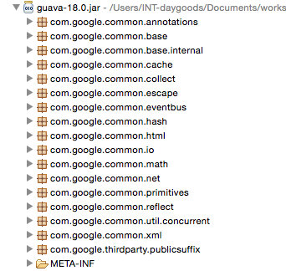
Google Guava?
제공되는 기능

Slide 23
Google Guava?
Basic
23

Slide 24
Google Guava?
com.google.common.base.String
static String nullToEmpty(String string)
Strings.nullToEmpty("TEST");
// TEST
Strings.nullToEmpty("");
// “”
Strings.nullToEmpty(null);
// “”

Slide 25
Google Guava?
com.google.common.base.String
static String emptyToNull(String string)
Strings.emptyToNull("TEST");
// TEST
Strings.emptyToNull("");
// null
Strings.emptyToNull(null);
// null

Slide 26
Google Guava?
com.google.common.base.String
static boolean isNullOrEmpty(String string)
Strings.isNullOrEmpty("TEST");
// false
Strings.isNullOrEmpty("");
// true
Strings.isNullOrEmpty(null);
// null

Slide 27
Google Guava?
com.google.common.base.Optional
static <T> Optional<T> of(T reference)
Optional<Integer> possible = Optional.of(5);
possible.get();
// 5

Slide 28
Google Guava?
com.google.common.base.Optional
static <T> Optional<T> of(T reference)
Optional<Integer> possible = Optional.of(null);
// NullPointerException

Slide 29
Google Guava?
com.google.common.base.Optional
abstract boolean isPresent()
Optional<Integer> possible = Optional.of(5);
possible.isPresent();
// true
possible.get();
// 5

Slide 30
Google Guava?
com.google.common.base.Optional
static <T> Optional<T> absent()
Optional<Integer> possible = Optional.absent();
possible.isPresent();
// false

Slide 31
Google Guava?
com.google.common.base.Optional
static <T> Optional<T> fromNullable(T nullableReference)
Optional<Integer> possible = Optional.fromNullable(null);
possible.isPresent();
// false

Slide 32
Google Guava?
com.google.common.base.Optional
abstract Optional<T> or(Optional<? extends T> secondChoice)
Optional<Integer> impossible = Optional.fromNullable(null);
impossible.isPresent();
// false
impossible.or(3);
// 3
Optional<Integer> possible = Optional.fromNullable(2);
impossible.or(possible).get();
// 2

Slide 33
Google Guava?
Bakery.java
public class Bakery {
private BakeryType type;
private String name;
private Integer saleCnt;
public Bakery(BakeryType type, String name) {
this.type = type;
this.name = name;
this.saleCnt = 0;
}
// getter
// setter
}
33

Slide 34
Google Guava?
BakeryType.java
public enum BakeryType {
BREAD,
MILK
}

Slide 35
Google Guava?
com.google.common.base.Optional
Example
Bakery bakery = new Bakery(BakeryType.BREAD, "크림빵")
Optional<Bakery> bakery = Optional.fromNullable(bakery);
if (bakery.isPresent()) {
Bakery bakery = bakery.get();
bakery.getType();
// BakeryType.BREAD
bakery.getName();
// "크림빵”
}

Slide 36
Google Guava?
com.google.common.base.Optional
Example
Optional<BakeryType> type = Enums.getIfPresent(BakeryType.class, ”BREAD");
type.isPresent();
// true
type.get();
// BakeryType.BREAD

Slide 37
Google Guava?
com.google.common.base.Optional
Example
Optional<BakeryType> type = Enums.getIfPresent(BakeryType.class, ”");
type.isPresent();
// false
Optional<BakeryType> type = Enums.getIfPresent(BakeryType.class, null);
// NullPointerException
Enums.getIfPresent(BakeryType.class, Strings.nullToEmpty(string));

Slide 38
Google Guava?
com.google.common.base.Optional
Practical application
public enum ApprovalType {
NORMAL("일반기안문", false),
PURCHASE("구매품의", true);
@Getter
private final String comment;
@Getter
private final boolean isENac;
private ApprovalType(String comment, boolean isENac) {
this.comment = comment;
this.isENac = isENac;
}
public static Optional<ApprovalType> find(String name) {
return Enums.getIfPresent(ApprovalType.class, Strings.nullToEmpty(name));
}
}
38

Slide 39
Google Guava?
com.google.common.base.Optional
Practical application
@RequestMapping("/approval/form/{type}")
public ModelAndView approvalForm(
ModelAndView mnv,
@PathVariable("type") String type) {
// 잘못된 품의 타입일 경우 처리
Optional<ApprovalType> optionalApprovalType = ApprovalType.find(type);
if (Boolean.FALSE.equals(optionalApprovalType.isPresent())) {
optionalApprovalType = Optional.of(ApprovalType.NORMAL);
}
ApprovalType aprovalType = optionalApprovalType.get();
39
39

Slide 40
Google Guava?
Preconditions

Slide 41
Google Guava?
com.google.common.base.Preconditions
static void checkArgument(boolean expression)
static void checkArgument(boolean expression, Object errorMessage)
static void checkArgument(boolean expression, String errorMessageTemplate, Object... errorMessageArgs)
int checkId = 0;
Preconditions.checkArgument(checkId > 0, "아이디 %s 는 0 보다 커야 합니다.",
checkId);
// throw new IllegalArgumentException();

Slide 42
Google Guava?
com.google.common.base.Preconditions
static <T> T checkNotNull(T reference)
static <T> T checkNotNull(T reference, Object errorMessage)
static <T> T checkNotNull(T reference, String errorMessageTemplate, Object... errorMessageArgs)
String checkName = null;
Preconditions.checkNotNull(checkName, "이름 : %s 은 널일 수 없습니다.",
checkName);
// throw new NullPointerException ();

Slide 43
Google Guava?
com.google.common.base.Preconditions
static int checkElementIndex(int index, int size)
List<Integer> checkItems = Lists.newArrayList();
checkItems.add(1);
Preconditions.checkElementIndex(2, checkItems.size());
// throw new IndexOutOfBoundsException ();

Slide 44
Google Guava?
Ordering

Slide 45
Google Guava?
Bakery.java
public class Bakery {
private BakeryType type;
private String name;
private Integer saleCnt;
public Bakery(BakeryType type, String name, Integer saleCnt) {
this.type = type;
this.name = name;
this.saleCnt = saleCnt;
}
// getter
// setter
}
45

Slide 46
Google Guava?
BakeryType.java
public enum BakeryType {
BREAD,
MILK
}

Slide 47
Google Guava?
com.google.common.collect.Ordering
abstract class Ordering<T>
Ordering<Bakery> SALE_CNT_ORDERING = new Ordering<Bakery>() {
@Override
public int compare(Bakery left, Bakery right) {
return Ints.compare(left.getSaleCnt(), right.getSaleCnt());
}
};

Slide 48
Google Guava?
com.google.common.collect.Ordering
Constructor Ordering()
private List<Bakery> bakeryList = Lists.newArrayList();
bakeryList.add(new Bakery(BakeryType.BREAD, "크림빵", 20));
bakeryList.add(new Bakery(BakeryType.BREAD, “소보로빵", 12));
bakeryList.add(new Bakery(BakeryType.BREAD, ”건빵", 300));
Collections.sort(bakeryList, Bakery.SALE_CNT_ORDERING);
// 소보로빵, 크림빵, 건빵

Slide 49
Google Guava?
com.google.common.collect.Ordering
<F> Ordering<F> onResultOf(Function<F,? extends T> function)
private List<Bakery> bakeryList = Lists.newArrayList();
bakeryList.add(new Bakery(BakeryType.BREAD, "크림빵", 20));
bakeryList.add(new Bakery(BakeryType.BREAD, “소보로빵", 12));
bakeryList.add(new Bakery(BakeryType.BREAD, ”건빵", 300));
Ordering.natural().nullsFirst().onResultOf(Bakery.SALE_CNT_FILTER);
// 소보로빵, 크림빵, 건빵

Slide 50
Google Guava?
com.google.common.collect.Ordering
Ordering<S> reverse()
private List<Bakery> bakeryList = Lists.newArrayList();
bakeryList.add(new Bakery(BakeryType.BREAD, "크림빵", 20));
bakeryList.add(new Bakery(BakeryType.BREAD, “소보로빵", 12));
bakeryList.add(new Bakery(BakeryType.BREAD, ”건빵", 300));
Collections.sort(bakeryList, Bakery.SALE_CNT_ORDERING.reverse());
// 건빵, 크림빵, 소보로빵

Slide 51
Google Guava?
com.google.common.collect.Ordering
Example : String Min, Max Value
private List<String> STRING_LIST = Lists.newArrayList("D", "B", "C", "A");
Ordering.from(String.CASE_INSENSITIVE_ORDER).min(STRING_LIST);
// A
Ordering.from(String.CASE_INSENSITIVE_ORDER).max(STRING_LIST);
// D

Slide 52
Google Guava?
com.google.common.collect.Ordering
Example : Integer Min, Max Value
private List<Integer> INTEGER_LIST = Lists.newArrayList(4, 2, 3, 1);
Ordering.natural().min(INTEGER_LIST);
// 1
Ordering.natural().max(INTEGER_LIST);
// 4

Slide 53
Google Guava?
com.google.common.collect.Ordering
Example : Integer leastOf(ASC), greatestOf(DESC) Value
private List<Integer> INTEGER_LIST = Lists.newArrayList(4, 2, 3, 1);
Ordering.natural().leastOf(INTEGER_LIST, INTEGER_LIST.size());
// 1, 2, 3, 4
Ordering.natural().greatestOf(INTEGER_LIST, INTEGER_LIST.size());
// 4, 3, 2, 1

Slide 54
Google Guava?
com.google.common.collect.Ordering
Example : nullsFirst, nullsLast
private List<Integer> INTEGER_LIST = Lists.newArrayList(null, 2, 3, 1);
Collections.sort(INTEGER_LIST, Ordering.natural().nullsFirst());
// null, 1, 2, 3
Collections.sort(INTEGER_LIST, Ordering.natural().nullsLast());
// 1, 2, 3, null

Slide 55
Google Guava?
String

Slide 56
Google Guava?
com.google.common.base.Joiner
static Joiner on(char separator)
private List<String> stringList = Lists.newArrayList();
stringList.add("Hello");
stringList.add("world");
stringList.add("!");
Joiner.on(“ ").join(stringList);
// Hello world !

Slide 57
Google Guava?
com.google.common.base.Joiner
Joiner skipNulls()
private List<String> stringList = Lists.newArrayList();
stringList.add("Hello");
stringList.add("world");
stringList.add(null);
stringList.add("!");
Joiner.on(“ "). skipNulls().join(stringList);
// Hello world !

Slide 58
Google Guava?
com.google.common.base.Joiner
static class Joiner.MapJoiner
private Map<String, Object> stringMap = Maps.newHashMap();
stringMap.put("searchKey", "ID");
stringMap.put("searchVal", 123);
Joiner.MapJoiner joinerMapJoiner = Joiner.on('&').withKeyValueSeparator("=");
joinerMapJoiner.join(stringMap);
// searchKey=ID&searchVal=123

Slide 59
Google Guava?
com.google.common.base.Splitter
static Splitter on(char separator)
static Splitter on(CharMatcher separatorMatcher)
static Splitter on(Pattern separatorPattern)
static Splitter on(String separator)
private String stringMessage = "Hello//world //!";
Splitter.on("/").split(stringMessage);
// Hello, , world , , !

Slide 60
Google Guava?
com.google.common.base.Splitter
Splitter trimResults()
private String stringMessage = "Hello//world //!";
Splitter.on("/").trimResults().split(stringMessage);
// Hello, , world, , !

Slide 61
Google Guava?
com.google.common.base.Splitter
Splitter omitEmptyStrings()
private String stringMessage = "Hello//world //!";
Splitter.on("/").trimResults().omitEmptyStrings().split(stringMessage);
// Hello, world, !

Slide 62
Google Guava?
com.google.common.base.Splitter
static class Splitter.MapSplitter
private String stringMessage = "searchKey=ID&searchVal=123";
Splitter.MapSplitter splitterMapSplitter = Splitter.on("&").trimResults()
.omitEmptyStrings()
.withKeyValueSeparator("=");
splitterMapSplitter.split(stringParemeter);
// {searchKey=ID, searchVal=123}

Slide 63
Google Guava?
com.google.common.html.HtmlEscapers
static Escaper htmlEscaper()
HTML_TO_ESCAPE = "<html><p>Escape this</p></html>";
String actual = HtmlEscapers.htmlEscaper().escape(HTML_TO_ESCAPE);
// &lt;html&gt;&lt;p&gt;Escape this&lt;/p&gt;&lt;/html&gt;
63

Slide 64
Google Guava?
com.google.common.base.CharMatcher
String removeFrom(CharSequence sequence)
String testText = " 나 이 키 ";
String actual = CharMatcher.WHITESPACE.removeFrom(testText);
// "나이키");
64
64

Slide 65
Google Guava?
Collect - Sets

Slide 66
Google Guava?
com.google.common.collect.Sets
static <E> HashSet<E> newHashSet()
private List<String> dataList = Arrays.asList( "크림빵",
"단팥빵", "단팥빵",
"건빵", "건빵", "건빵",
"식빵", "식빵", "식빵", "식빵”);
private Set<String> setItems = Sets.newHashSet(dataList);
// 크림빵, 단팥빵, 건빵, 식빵

Slide 67
Google Guava?
com.google.common.collect.Sets
static <E> Set<E> filter(Set<E> unfiltered, Predicate<? super E> predicate)
Set<String> actual = Sets.filter(setItems, new Predicate<String>() {
@Override
public boolean apply(String input) {
return "건빵".equals(input) || "크림빵".equals(input);
}
});
// 크림빵, 건빵

Slide 68
Google Guava?
com.google.common.collect.Sets
static <E> Sets.SetView<E> union(Set<? extends E> set1, Set<? extends E> set2)
Set<String> milk = Sets.newHashSet("딸기우유");
Set<String> bread = Sets.filter(setItems, new Predicate<String>() {
@Override
public boolean apply(String input) {
return "식빵".equals(input);
}
});
Set<String> actual = Sets.union(milk, bread);
// 딸기우유, 식빵

Slide 69
Google Guava?
Collect - Maps

Slide 70
Google Guava?
com.google.common.collect.Maps
static <K,V> HashMap<K,V> newHashMap()
Map<String, Bakery> actual = Maps.newHashMap();
// {}

Slide 71
Google Guava?
com.google.common.collect.Maps
static <K,V> ImmutableMap<K,V> uniqueIndex(Iterable<V> values, Function<? super V,K> keyFunction)
private List<Bakery> bakeryList = Lists.newArrayList();
bakeryList.add(new Bakery(BakeryType.BREAD, "크림빵", 12));
bakeryList.add(new Bakery(BakeryType.BREAD, "소보로빵", 20));
bakeryList.add(new Bakery(BakeryType.MILK, "딸기우유", 300));
Maps.uniqueIndex(bakeryList, Bakery.NAME_FILTER);
// {크림빵=[type=BREAD,name=크림빵,saleCnt=12],
소보로빵=[type=BREAD,name=소보로빵,saleCnt=20],
딸기우유=[type=MILK,name=딸기우유,saleCnt=300]}

Slide 72
Google Guava?
Bakery.java
public static final Function<Bakery, String> NAME_FILTER = new Function<Bakery, String>() {
@Override
public String apply(Bakery input) {
return input.getName();
}
};

Slide 73
Google Guava?
com.google.common.collect.Maps
static <K,V> Map<K,V> filterEntries(Map<K,V> unfiltered, Predicate<? super Map.Entry<K,V>> entryPredicate)
Maps.filterEntries(mapItems, Bakery.MAP_ENTRY_TYPE_FINDER(BakeryType.MILK));
// {딸기우유=[type=MILK,name=딸기우유,saleCnt=300]}

Slide 74
Google Guava?
Bakery.java
public static final Predicate<Map.Entry<String, Bakery>> MAP_ENTRY_TYPE_FINDER(final BakeryType type) {
return new Predicate<Map.Entry<String, Bakery>>() {
@Override
public boolean apply(Map.Entry<String, Bakery> input) {
return (type.equals(input.getValue().getType()));
}
};
}

Slide 75
Google Guava?
com.google.common.collect.Maps
static <K,V> Map<K,V> filterValues(Map<K,V> unfiltered, Predicate<? super V> valuePredicate)
Maps.filterValues(mapItems, new Predicate<Bakery>() {
@Override
public boolean apply(Bakery input) {
return input.getSaleCnt() > 20;
}
});
// {딸기우유=[type=MILK,name=딸기우유,saleCnt=300]}

Slide 76
Google Guava?
Collect - Multiset

Slide 77
Google Guava?
com.google.common.collect.Multiset<E>
int size()
private List<String> dataList = Arrays.asList( "크림빵",
"단팥빵", "단팥빵",
"건빵", "건빵", "건빵",
"식빵", "식빵", "식빵", "식빵”);
private Multiset<String> multisetItems = HashMultiset.create(dataList);
multisetItems.size();
// 10

Slide 78
Google Guava?
com.google.common.collect.Multiset<E>
int count(Object element)
private List<String> dataList = Arrays.asList( "크림빵",
"단팥빵", "단팥빵",
"건빵", "건빵", "건빵",
"식빵", "식빵", "식빵", "식빵”);
private Multiset<String> multisetItems = HashMultiset.create(dataList);
multisetItems.contains("식빵");
// true

Slide 79
Google Guava?
com.google.common.collect.Multiset<E>
Set<Multiset.Entry<E>> entrySet()
private List<String> dataList = Arrays.asList( "크림빵",
"단팥빵", "단팥빵",
"건빵", "건빵", "건빵",
"식빵", "식빵", "식빵", "식빵”);
private Multiset<String> multisetItems = HashMultiset.create(dataList);
multisetItems.count("단팥빵");
// 2

Slide 80
Google Guava?
com.google.common.collect.Multiset<E>
boolean contains(Object element)
private List<String> dataList = Arrays.asList( "크림빵",
"단팥빵", "단팥빵",
"건빵", "건빵", "건빵",
"식빵", "식빵", "식빵", "식빵”);
private Multiset<String> multisetItems = HashMultiset.create(dataList);
multisetItems.entrySet();
// 건빵 : 3, 크림빵 : 1, 식빵 : 4, 단팥빵 : 2

Slide 81
Google Guava?
Collect - Multimap
81

Slide 82
Google Guava?
com.google.common.collect.Multimap<K,V>
Construct
Multimap<String, String> actual = ArrayListMultimap.create();
multimapItems.put("빵", "크림빵");
multimapItems.put("빵", "단팥빵");
multimapItems.put("빵", "소보로빵");
multimapItems.put("우유", "초코우유");
multimapItems.put("우유", "딸기우유");
multimapItems.put("과일", "싫어");
// {빵=[크림빵, 단팥빵, 소보로빵], 과일=[싫어], 우유=[초코우유, 딸기우유]}

Slide 83
Google Guava?
com.google.common.collect.Multimap<K,V>
int size()
Multimap<String, String> actual = ArrayListMultimap.create();
multimapItems.put("빵", "크림빵");
multimapItems.put("빵", "단팥빵");
multimapItems.put("빵", "소보로빵");
multimapItems.put("우유", "초코우유");
multimapItems.put("우유", "딸기우유");
multimapItems.put("과일", "싫어");
multimapItems.size();
// 6

Slide 84
Google Guava?
com.google.common.collect.Multimap<K,V>
boolean containsKey(Object key)
Multimap<String, String> actual = ArrayListMultimap.create();
multimapItems.put("빵", "크림빵");
multimapItems.put("빵", "단팥빵");
multimapItems.put("빵", "소보로빵");
multimapItems.put("우유", "초코우유");
multimapItems.put("우유", "딸기우유");
multimapItems.put("과일", "싫어");
multimapItems.containsKey("빵");
// true

Slide 85
Google Guava?
com.google.common.collect.Multimap<K,V>
boolean containsValue(Object value)
Multimap<String, String> actual = ArrayListMultimap.create();
multimapItems.put("빵", "크림빵");
multimapItems.put("빵", "단팥빵");
multimapItems.put("빵", "소보로빵");
multimapItems.put("우유", "초코우유");
multimapItems.put("우유", "딸기우유");
multimapItems.put("과일", "싫어");
multimapItems.containsValue("초코우유");
// true

Slide 86
Google Guava?
com.google.common.collect.Multimap<K,V>
Collection<V> get(K key)
Multimap<String, String> actual = ArrayListMultimap.create();
multimapItems.put("빵", "크림빵");
multimapItems.put("빵", "단팥빵");
multimapItems.put("빵", "소보로빵");
multimapItems.put("우유", "초코우유");
multimapItems.put("우유", "딸기우유");
multimapItems.put("과일", "싫어");
List<String> actual = Lists.newArrayList(multimapItems.get("우유"));
// [초코우유, 딸기우유]

Slide 87
Google Guava?
Collect - Multimaps

Slide 88
Google Guava?
com.google.common.collect.Multimaps
static <K,V> ImmutableListMultimap<K,V> index(Iterable<V> values, Function<? super V,K> keyFunction)
private List<Bakery> bakeryList = Lists.newArrayList();
bakeryList.add(new Bakery(BakeryType.BREAD, "크림빵", 12));
bakeryList.add(new Bakery(BakeryType.BREAD, "소보로빵", 20));
bakeryList.add(new Bakery(BakeryType.MILK, "딸기우유", 300));
ImmutableListMultimap<BakeryType, Bakery> actual = Multimaps.index(bakeryList, Bakery.TYPE_FILTER);
actual.size(); // 3
actual.get(BakeryType.BREAD).size(); // 2
actual.get(BakeryType.MILK).size(); // 1

Slide 89
Google Guava?
Collect - Lists

Slide 90
Google Guava?
com.google.common.collect.Lists
static <E> ArrayList<E> newArrayList()
static <E> ArrayList<E> newArrayList(E... elements)
Lists.newArrayList();
// []
Lists.newArrayList("크림빵", "소보로빵");
// 크림빵, 소보로빵

Slide 91
Google Guava?
com.google.common.collect.Lists
static <E> ArrayList<E> newArrayList(Iterable<? extends E> elements)
private List<Bakery> bakeryList = Lists.newArrayList();
bakeryList.add(new Bakery(BakeryType.BREAD, "크림빵", 12));
bakeryList.add(new Bakery(BakeryType.BREAD, "소보로빵", 20));
bakeryList.add(new Bakery(BakeryType.MILK, "딸기우유", 300));
Lists.newArrayList(bakeryList);
// 크림빵, 소보로빵, 딸기우유

Slide 92
Google Guava?
com.google.common.collect.Lists
static <E> ArrayList<E> newArrayList(Iterable<? extends E> elements)
private Set<Bakery> bakerySet = Sets.newHashSet();
bakerySet.add(new Bakery(BakeryType.BREAD, "크림빵", 12));
bakerySet.add(new Bakery(BakeryType.BREAD, "소보로빵", 20));
bakerySet.add(new Bakery(BakeryType.MILK, "딸기우유", 300));
Lists.newArrayList(bakerySet);
// 크림빵, 소보로빵, 딸기우유 (순서 보장 안함)

Slide 93
Google Guava?
com.google.common.collect.Lists
static <T> List<T> reverse(List<T> list)
private List<Bakery> bakeryList = Lists.newArrayList();
bakeryList.add(new Bakery(BakeryType.BREAD, "크림빵", 12));
bakeryList.add(new Bakery(BakeryType.BREAD, "소보로빵", 20));
bakeryList.add(new Bakery(BakeryType.MILK, "딸기우유", 300));
Lists.reverse(bakeryList);
// 딸기우유, 소보로빵, 크림빵

Slide 94
Google Guava?
com.google.common.collect.Lists
static <T> List<List<T>> partition(List<T> list, int size)
private List<Bakery> bakeryList = Lists.newArrayList();
bakeryList.add(new Bakery(BakeryType.BREAD, "크림빵", 12));
bakeryList.add(new Bakery(BakeryType.BREAD, "소보로빵", 20));
bakeryList.add(new Bakery(BakeryType.MILK, "딸기우유", 300));
Lists.partition(bakeryList, 2);
// [[크림빵, 소보로빵], [딸기우유]]

Slide 95
Google Guava?
com.google.common.collect.Lists
static <F,T> List<T> transform(List<F> fromList, Function<? super F,? extends T> function)
private List<Bakery> bakeryList = Lists.newArrayList();
bakeryList.add(new Bakery(BakeryType.BREAD, "크림빵", 12));
bakeryList.add(new Bakery(BakeryType.BREAD, "소보로빵", 20));
bakeryList.add(new Bakery(BakeryType.MILK, "딸기우유", 300));
List<BakeryType> actual = Lists.transform(bakeryList, Bakery.TYPE_FILTER);
// [BakeryType.BREAD, BakeryType.MILK]

Slide 96
Google Guava?
Bakery.java
public static final Function<Bakery, BakeryType> TYPE_FILTER = new Function<Bakery, BakeryType>() {
@Override
public BakeryType apply(Bakery input) {
return input.getType();
}
};

Slide 97
Google Guava?
Collect – Iterables

Slide 98
Google Guava?
com.google.common.collect.Iterables
setUp Medel
private List<Bakery> bakeryList = Lists.newArrayList();
bakeryList.add(new Bakery(BakeryType.BREAD, "크림빵", 12));
bakeryList.add(new Bakery(BakeryType.BREAD, "소보로빵", 20));
bakeryList.add(new Bakery(BakeryType.BREAD, "건빵", 0));
bakeryList.add(new Bakery(BakeryType.BREAD, "식빵", 10));
bakeryList.add(new Bakery(BakeryType.MILK, "딸기우유", 300));
bakeryList.add(new Bakery(BakeryType.MILK, "초코우유", 300));
bakeryList.add(new Bakery(BakeryType.JUICE, "사과주스", 300));

Slide 99
Google Guava?
com.google.common.collect.Iterables
static <T> Iterable<T> filter(Iterable<T> unfiltered, Predicate<? super T> predicate)
Lists.newArrayList(Iterables.filter(bakeryList, Bakery.TYPE_FINDER(BakeryType.MILK)));
// [[type=MILK,name=딸기우유,saleCnt=300],
[type=MILK,name=초코우유,saleCnt=300]]

Slide 100
Google Guava?
com.google.common.collect.Iterables
static <T> Iterable<T> concat(Iterable<? extends T> a, Iterable<? extends T> b)
Iterable<Bakery> milks = Iterables.filter(bakeryList, Bakery.TYPE_FINDER(BakeryType.MILK));
Iterable<Bakery> juices = Iterables.filter(bakeryList, Bakery.TYPE_FINDER(BakeryType.JUICE));
Lists.newArrayList(Iterables.concat(milks, juices));
// [[type=MILK,name=딸기우유,saleCnt=300],
[type=MILK,name=초코우유,saleCnt=300],
[type=JUICE,name=사과주스,saleCnt=300]]

Slide 101
Google Guava?
com.google.common.collect.Iterables
static <T> T find(Iterable<T> iterable, Predicate<? super T> predicate)
Iterables.find(bakeryList, Bakery.TYPE_FINDER(BakeryType.MILK));
// [type=MILK,name=딸기우유,saleCnt=300]
private List<String> stringList = Lists.newArrayList(null, "크림빵", null, "딸기우유");
Iterables.find(stringList, Predicates.notNull());
// 크림빵

Slide 102
Google Guava?
com.google.common.collect.Iterables
static <T> Optional<T> tryFind(Iterable<T> iterable, Predicate<? super T> predicate)
Optional<Bakery> actual = Iterables.tryFind(bakeryList, Bakery.TYPE_FINDER(BakeryType.MILK));
actual.isPresent();
// true
actual.get().getName();
// "딸기우유"

Slide 103
Google Guava?
com.google.common.collect.Iterables
static <T> T getFirst(Iterable<? extends T> iterable, T defaultValue)
Iterables.getFirst(bakeryList, null);
//[type=BREAD,name=크림빵,saleCnt=12]

Slide 104
Google Guava?
com.google.common.collect.Iterables
static <T> T getLast(Iterable<? extends T> iterable, T defaultValue)
Iterables.getLast(bakeryList, null);
// [type=JUICE,name=사과주스,saleCnt=300]

Slide 105
Google Guava?
com.google.common.collect.Iterables
static <T> boolean all(Iterable<T> iterable, Predicate<? super T> predicate)
Iterables.all(bakeryList, Bakery.TYPE_FINDER(BakeryType.MILK));
// false

Slide 106
Google Guava?
com.google.common.collect.Iterables
static <T> boolean any(Iterable<T> iterable, Predicate<? super T> predicate)
Iterables.any(bakeryList, Bakery.TYPE_FINDER(BakeryType.MILK));
// true

Slide 107
Google Guava?
com.google.common.collect.Iterables
static int size(Iterable<?> iterable)
Iterables.size(bakeryList);
// 7

Slide 108
Google Guava?
com.google.common.collect.Iterables
static <T> T get(Iterable<T> iterable, int position)
Iterables.get(bakeryList, 6);
// [type=JUICE,name=사과주스,saleCnt=300]

Slide 109
Google Guava?
com.google.common.collect.Iterables
static <F,T> Iterable<T> transform(Iterable<F> fromIterable, Function<? super F,? extends T> function)
Lists.newArrayList(Iterables.transform(bakeryList, Bakery.TYPE_FILTER));
// [BREAD, BREAD, BREAD, BREAD, MILK, MILK, JUICE]
Lists.newArrayList(Sets.newHashSet(Iterables.transform(bakeryList, Bakery.TYPE_FILTER)));
// [JUICE, BREAD, MILK]

Slide 110
Google Guava?
Guava Cache
110

Slide 111
Google Guava?
Caches
LoadingCache<Key, Graph> graphs = CacheBuilder.newBuilder()
.maximumSize(100)
.expireAfterAccess(10, TimeUnit.MINUTES)
.build(
new CacheLoader<Key, Graph>() {
public Graph load(Key key) { // no checked exception
return createExpensiveGraph(key);
}
});
...
return graphs.getUnchecked(key);

Slide 112
Google Guava?
com.google.common.cache.LoadingCache<K,V>
Interface LoadingCache<K,V>
PRIMARY KEY
private static final long CACHE_MAX_SIZE = 1000L;
private static final int CACHE_5_MINUTES = 5;
private LoadingCache<String, String> CACHE_ITEMS = CacheBuilder.newBuilder()
.maximumSize(CACHE_MAX_SIZE)
.expireAfterWrite(CACHE_5_MINUTES, TimeUnit.MINUTES)
.build(
new CacheLoader<String, String>() {
@Override
public String load(String key) throws Exception {
return getData(key);
}
}
);
112

Slide 113
Google Guava?
com.google.common.cache.LoadingCache<K,V>
Interface LoadingCache<K,V>
COMPOSITE KEY
private static final long CACHE_MAX_SIZE = 1000L;
private static final int CACHE_5_MINUTES = 5;
private LoadingCache<Pair<String, String>, String> CACHE_ITEMS_COMPOSITE_KEY =
CacheBuilder.newBuilder()
.maximumSize(CACHE_MAX_SIZE)
.expireAfterWrite(CACHE_5_MINUTES, TimeUnit.MINUTES)
.build(
new CacheLoader<Pair<String, String>, String>() {
@Override
public String load(Pair<String, String> key) throws Exception {
return getData(key.getLeft(), key.getRight());
}
});
113
113

Slide 114
Google Guava?
Q&A

Slide 115
Google Guava?
Reference sites
Homepage
https://code.google.com/p/guava-libraries/
User Guide
https://code.google.com/p/guava-libraries/wiki/GuavaExplained?tm=6
Guava docs
http://docs.guava-libraries.googlecode.com/git-history/release/javadoc/index.html
Example Site
http://www.leveluplunch.com/java/examples/#java-guava
Example Source
https://github.com/Neowizen/JavaStudy/tree/master/Source/GuavaExample

